Slide 1

Disaster Response and Reporting System
Client:
Dr. Mark Corson
Chairman, Department of Natural Sciences and
Professor, Department of Humanities and
Social Sciences
Mentor:
Dr. Ajay Bandi
Program coordinator MS-ACS
Team Members:
Chandra Mouli Kantipudi
Hemanth Narne
Kishan Kalburgi Srinivas
Sreevani Anoohya Tadiboina
Vineeth Agarwal
Team Synergic

Slide 2
Outline
Introduction
Proposed Solution
Requirements overview
Tools and Technologies
Demo
Tasks Accomplished
Lessons Learned
Future tasks
Hemanth

Slide 3


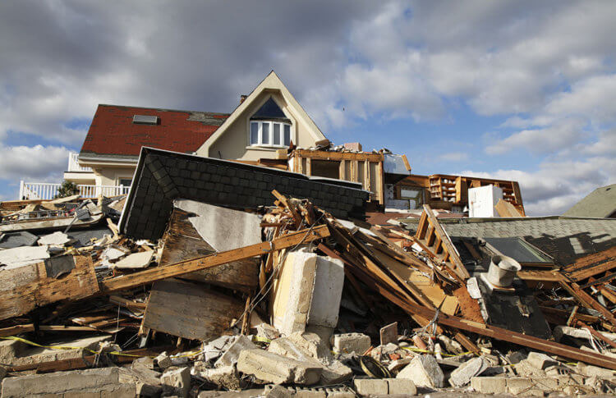
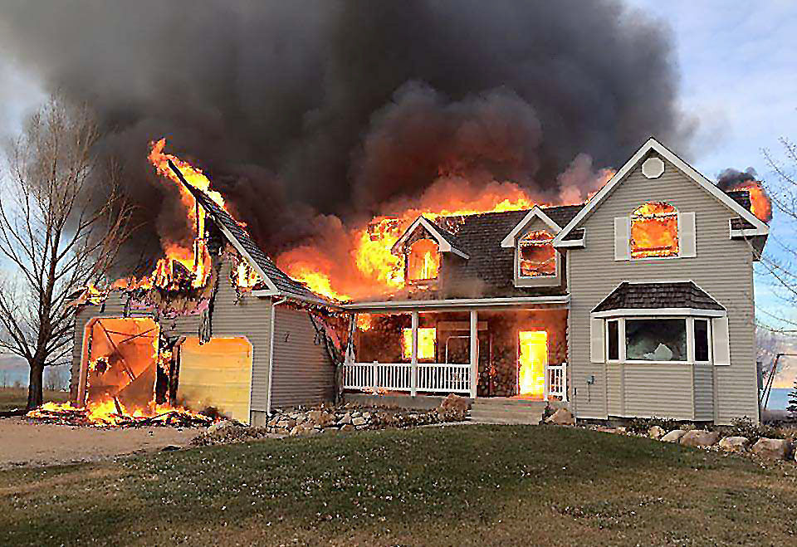
Introduction
Emergency Operations Center (EOC)
Walkie-talkie
Walkie-talkie
Problems:
No proper visualization of incident’s impact
No proper track of historical incidents
Chances of missing the reporting of key information like causalities, structural damage and others
No precise location information
Poor Audio Quality
Increase in wait time due to multiple reporting's at the same time
Earthquake disaster
Fire disaster

Slide 4


Proposed Solution
Emergency Operations Center (EOC)
Web Application
Mobile Application
Mobile Application
Earthquake disaster
Fire disaster

Slide 5
Requirements Overview
Web Application(EOC) | Mobile Application(CERT member)
No signup | Signup
Login | Login
Review all CERT applications received | Fill CERT application form and submit to EOC
Take decision to accept/deny an individual CERT applicant | Wait for confirmation notification from EOC
Create Incident module and send notification to CERT members | Accept/Deny availability notification
Create team and assign roles | View team members
Review reports sent by CERT members | Send Incident reports to EOC
Kishan Kalburgi Srinivas

Slide 6









Tools And Technologies
Kishan Kalburgi Srinivas

Slide 7






Tools And Technologies
Kishan Kalburgi Srinivas

Slide 8

It’s Demo Time
Chandra Mouli, Vineeth, Sreevani, Hemanth & Kishan

Slide 9
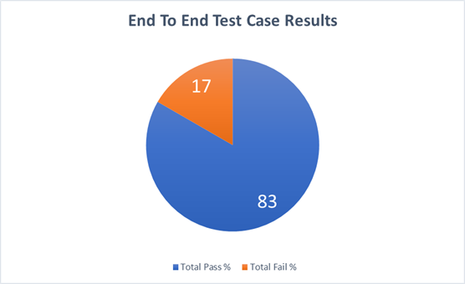
Hemanth

Slide 10
Software development methodology practiced
Agile
Daily standup meeting
By weekly client meeting
Sprints planning and deliveries
Vineeth

Slide 11
Tasks Accomplished in Mobile Application
User is able to signup, login and register
User is able to receive notifications sent from EOC
User is able to see the incident created by EOC
Generate reports on a particular disaster
Integrated Camera functionality
Added Authentication in mobile application
Sreevani Anoohya Tadiboina

Slide 12
Tasks Accomplished in Web Application
Added authentication in web application
EOC is able accept or deny the applicant
EOC is able to create incident.
Teams can be created for a particular incident along with update functionality
Integrated Maps in web application
List the reports of an incident
Generating reports for archived incident
Chandra Mouli Kantipudi

Slide 13
Problems Faced Lessons Learned
Database Design: Need to update multiple tables for same data
Push Notification: MongoDB provides many of the features to native applications only
AGM-Maps: agm-maps element was not recognized by browser even though it has agm/core library in node_modules
Modifying a Model/Schema : Need to change the API call from deployed to local version
Creation of a single table rather multiple tables for storing the details of the users
Using Firebase Database to send notifications to the mobile application
Do not have multiple versions mentioned for a library in package.json
Update in model of a class needs to be pushed in deployed server as well
Chandra Mouli Kantipudi

Slide 14
Future tasks
Display individual reports in mobile application
Providing access privileges
User Manual
Perform left over testing and generate test results for mobile and web application
Customized markers to show on map
Chandra Mouli Kantipudi

Slide 15
Acknowledgement
We would like to show our sincere gratitude to Dr. Mark Corson for being such an amazing client.
We would like to thank our mentor Dr. Ajay Bandi for being such a motivating guide throughout the course duration.
We would like to thank Lisa Crater for helping us schedule meetings with Dr. Corson.
Vineeth

Slide 16
Any Questions? or Suggestions?

Slide 17
Thank You

